Slide 1
Fit Nexus
– Wellness Tracking & Analytics Platform
PGCP-AC Feb 26 (CDAC Project)
Presented By:
Komal Ghodke - (260245920034)
Anuj Deshmukh - (260245920019)
Mayur Deo - (260245920042)
Pratik Diwan - (260245920060)
Sakshi Khandare - (260245920066)

Slide 2
TABLE OF CONTENTS
Introduction
Problem Statement
Objectives
Technology Stack
System Architecture
Flow Diagram
Sequence Diagram,
Class Diagram
Entity Diagram.
ER Diagram
Modules to be Implemented
Deployment
Future scope
Conclusion

Slide 3
1. Introduction
FIT NEXUS is a holistic wellness tracking platform.
Tracks workout, nutrition, sleep, and stress while aligning with MINISTRY OF AYUSH preventive health goals.
Uses AI/GenAI for predictive scoring, multilingual PDF reports, and personalized narration.
Offers a corporate dashboard for HR and trainers, plus map integration.
Anchored in the 6 Dimensions of Wellness (6Ds) for complete user guidance

Slide 4
Problem Statement
Current wellness apps are fragmented (fitness-only or diet-only).
Lack of integration across the 6Ds holistic wellness domains:
Emotional, Physical, Spiritual, Intellectual, Social, Occupational.
No personalized AI narration or culturally rooted recommendations.
Enterprises lack aggregated analytics for employee wellness.
Need for a secure, scalable, and culturally authentic platform that supports both individuals & organizations.

Slide 5
Objectives
Build a centralized ecosystem for holistic wellness tracking.
Integrate the 6Ds of wellness:
Emotional → mood journaling, stress awareness
Physical → workouts, nutrition, sleep quality
Spiritual → breathwork, reflection, mindfulness
Intellectual → curiosity, learning, mindful insights
Social → empathy, connection, shared wellness language
Occupational → balance, clarity, purpose in daily life
Provide secure authentication (JWT/OAuth) and scalable architecture.
Generate personalized insights, predictive scoring, and multilingual PDF reports.
Deliver a corporate dashboard (ASP.NET Core) for HR and trainers.
Ensure enterprise readiness with Docker deployment and Azure cloud credits.

Slide 6
2. Technology Stack
Frontend: React (Web)
Backend: Spring Boot (Java), ASP.NET Core (Corporate dashboard)
Database: MySQL
Tools: Docker, Postman, GitHub
Security: JWT Authentication
APIs: Google Maps API, SERP API, Google Gemini API, Fitbit API (future)

Slide 7
3. System Architecture
User → React Web → Backend (Spring Boot) → Database (MySQL)
AI/GenAI Layer → predictive scoring + narration
Docker containerization → Azure free tier deployment
ASP.NET Core dashboard

Slide 8
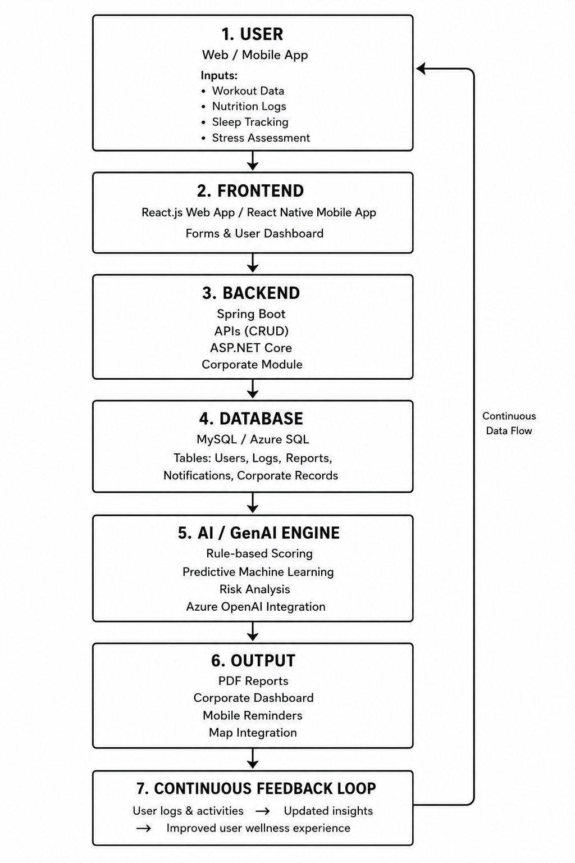
Proposed System Architecture

Slide 9
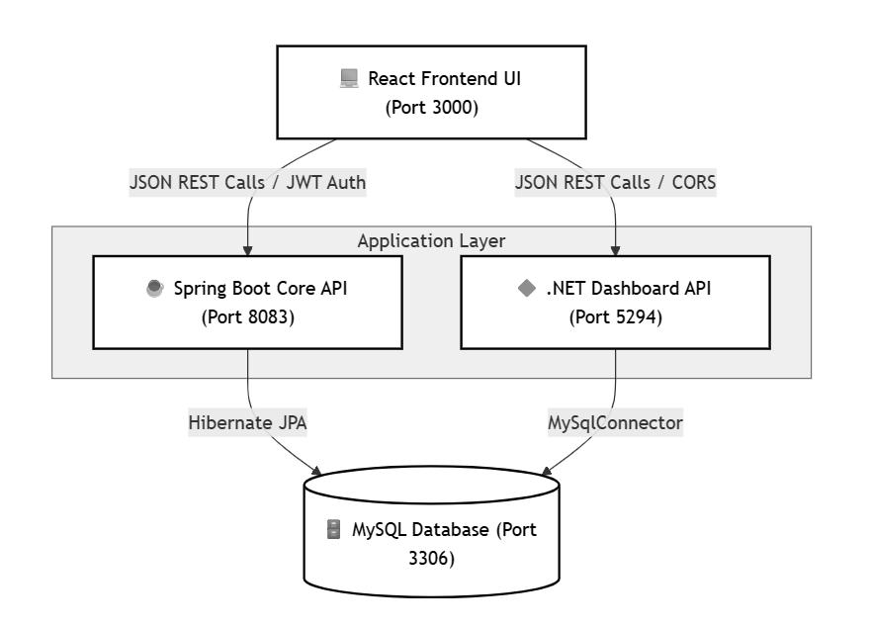
Diagram : System Flow

Slide 10
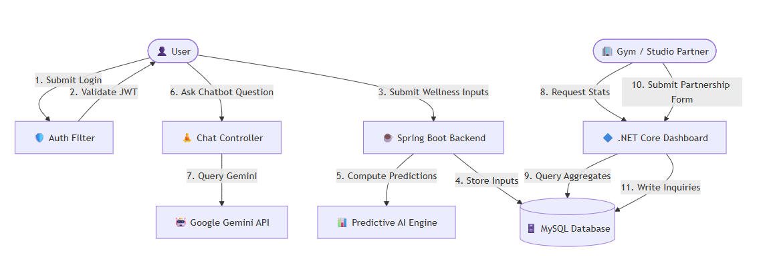
Flow Diagram

Slide 11
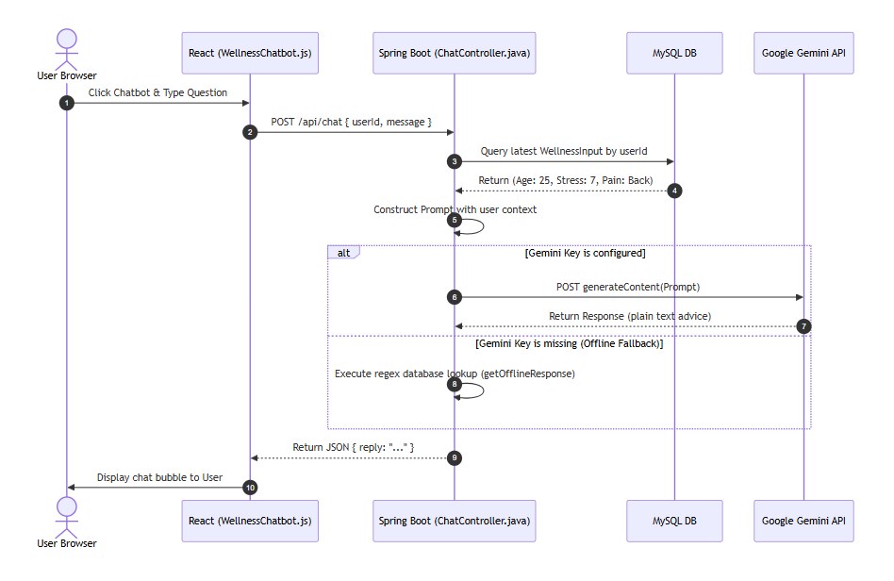
2. Sequence Diagram,

Slide 12
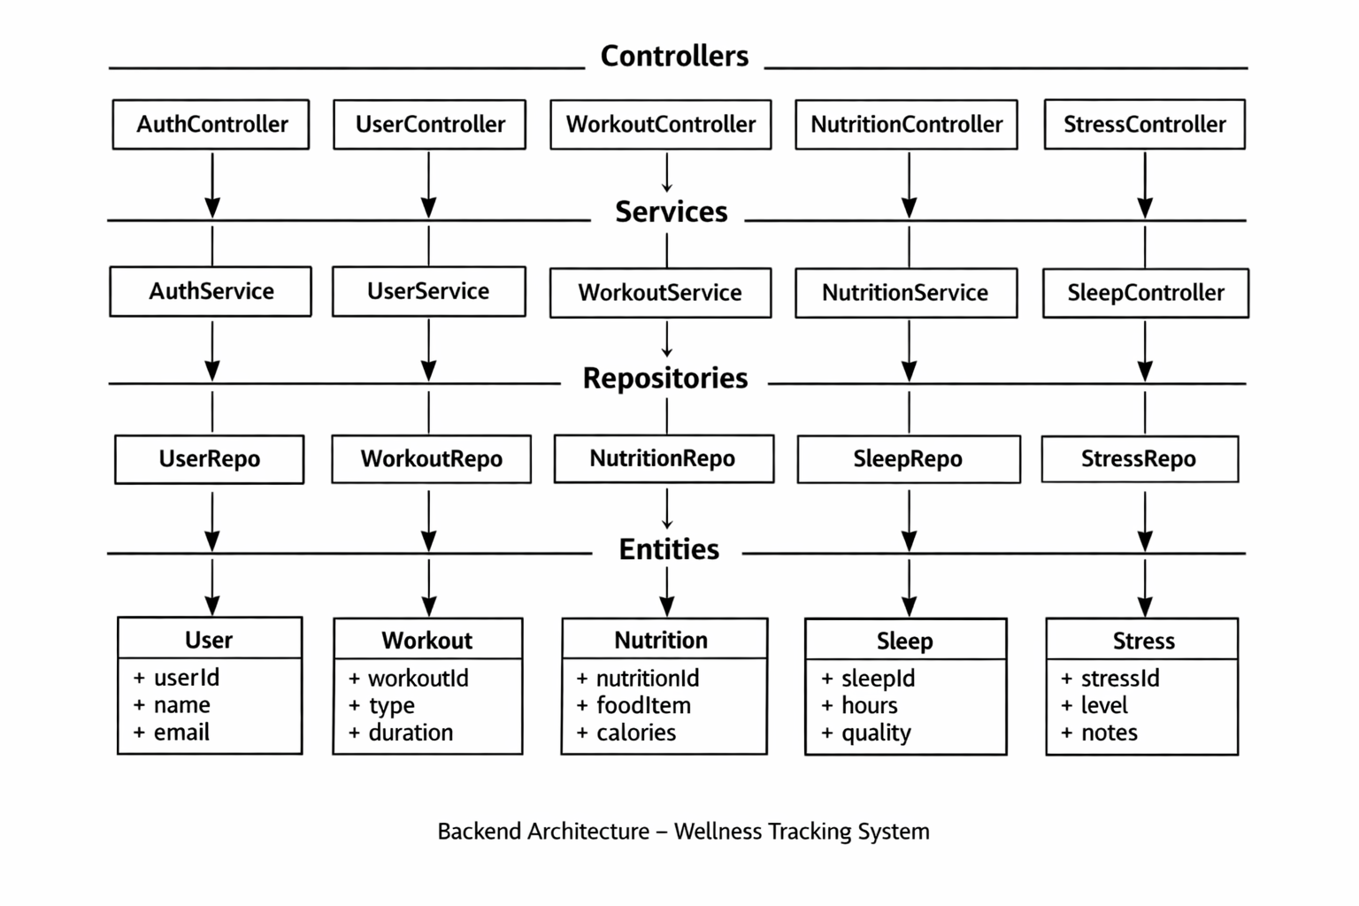
3. Class Diagram

Slide 13
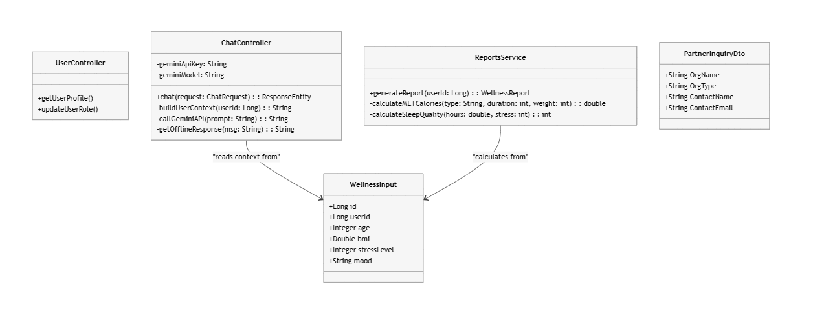
Class Diagram

Slide 14
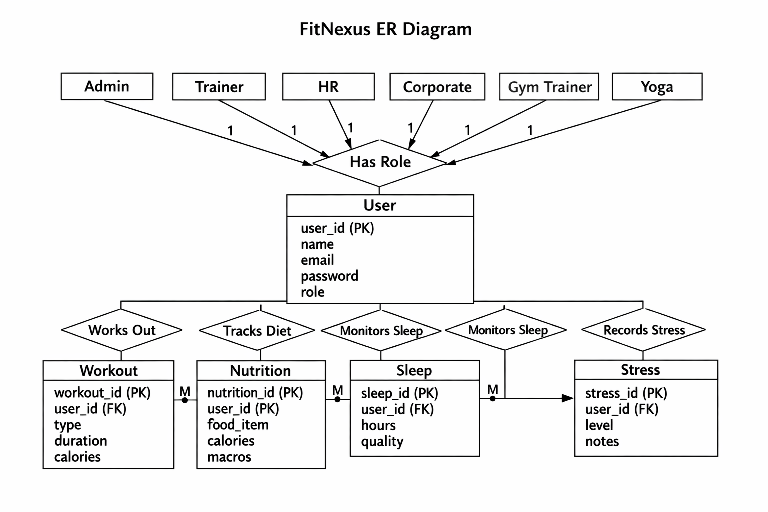
4. Entity Diagram.

Slide 15
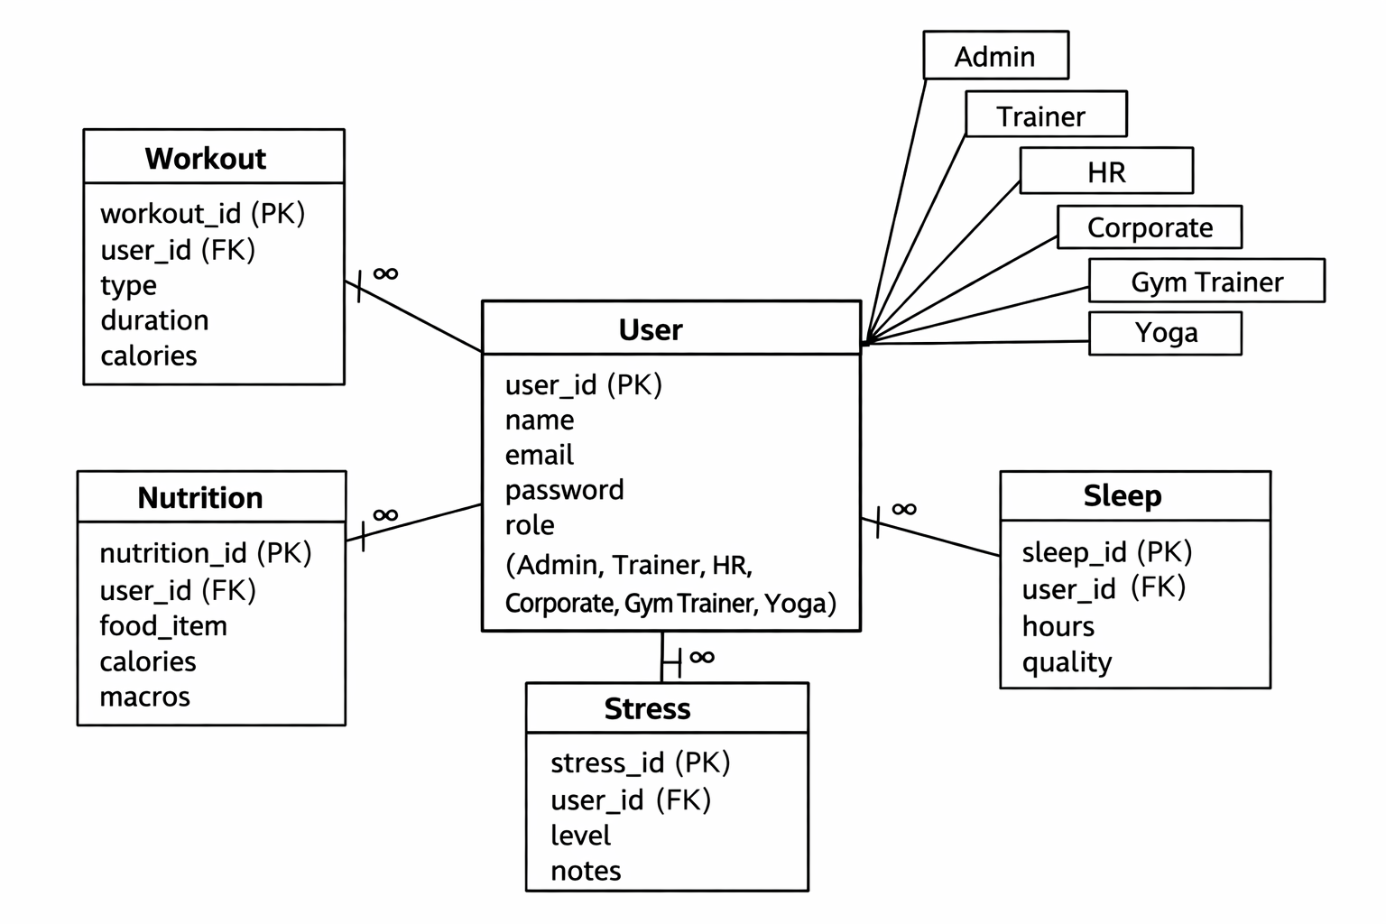
5. Entity Relationship Diagram

Slide 16
4. Modules to be Implemented
Authentication (Register/Login/Profile)
Workout tracking (type, duration, calories)
Nutrition tracking (food items, macros, calories)
Sleep tracking (hours, quality)
Stress tracking (level, notes)
Wellness assessment → PDF reports
AI scoring → calories, stress, sleep quality
GenAI narration → personalized health plans

Slide 17
5. Deployment
Containerized backend + frontend using Docker.
Deployed on Azure free tier (student credits).
Demonstrated CI/CD pipeline with GitHub integration.

Slide 18
6. Future Scope
Wearable connectivity via Fitbit API.
Expansion to enterprise wellness management.

Slide 19
7. Conclusion
The project will deliver a secure full‑stack wellness platform with tracking and analytics.
Users will manage wellness data and generate personalized reports.
AI/GenAI will provide predictive scoring and health guidance.
The system will be containerized and deployed on Azure, ensuring scalability.
Fit Nexus will evolve into an enterprise solution with wearable and dashboard integration.

Slide 20
Thank You!

